Slide 1

Predicting Default on Consumer Installment Loans using Lending Club Data
Ameet Rawtani

Slide 2
Executive Summary
Results:
All classification models able to better predict default for Grades E and F, with support vector machines, extra decision trees, and logistic regression having the best improvement (20-35%) over baseline.
For Grades E and F, our models also produces better gross returns: 12% for the model vs 4% in Grade F; and 16% vs 12% in Grade E for the models vs baseline
Followups:
Re-model default by loan grade to see if model’s ROC AUC score improves
Create a website that can accept loan characteristic input to predict if the loan will default

Slide 3
Question: Are we able to predict default and avoid lending to those customers?
Lending Club offers investors/lenders an internal risk score, credit data, other user-provided information, and the average default rate for that type of loan to judge whether to fund a loan or not
If we can better select loans unlikely to default (a loss-averse model) by grade of loan:
We could identify customers who are lower risk than they appear, and hence could be offered better terms;
We can be more selective than if we naively lend to everyone on Lending Club, or everyone in the band of risk score we care about

Slide 4
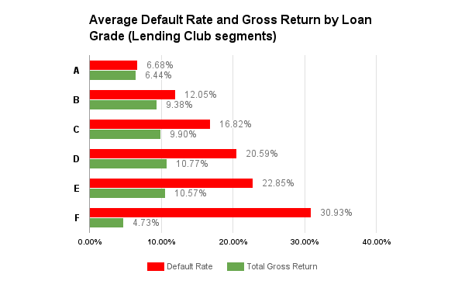
Since gross returns are not commensurate with risk taken on higher risk loan portfolios, we focused there to see if we can lower our observed default rates and increase returns

Slide 5
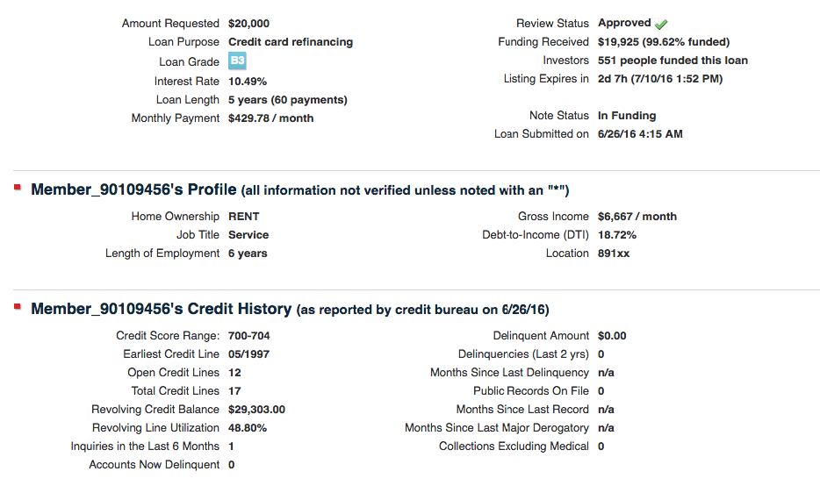
The screenshot below contains all the information a lender would see from Lending Club when deciding whether to lend or not

Slide 6
Process - Acquiring and Preparing the Data
Obtained full loan book data from Lending Club via: https://www.lendingclub.com/info/download-data.action
Chose to focus on 36 month loans that had fully aged in the worst loan grades
60 months: Data through Dec 2010 (these loans only started being offered in May 2010)
Prepared Data for Analysis:
Numerical Data (Credit Bureau Data, Loan Request details): Engineered dummy variables, scaled to account for outliers
External Data (Median HH income from American Community Survey): Engineered variable for comparison of credit risk
Performed Feature Extraction and Selection:
Attempted modeling continuous variables after reducing dimensions with PCA
Also attempted modeling on continuous and categorical variables after reducing features via Random Forest and Sequential Backwards Selection (SBS), using the selected features with the best ROC AUC score

Slide 7
Process: Which Data and Models
Data: I attempted modeling both with credit and income variables only, compressed with PCA, and Feature Selection of numerical and categorical data
Models: Because I was trying to classify loans into defaults and non-defaults, I elected for simple and complex classification models:
Logistic Regression
Support Vector Machines with an RBF kernel
Decision Tree Classification
Bagged Decision Tree Classification
Random Forest Classification
An ensemble of the best classifiers
Metric to evaluate performance: ROC AUC score as it would not overly favor classifying loans into the default category and hence risk denying every application to avoid default.

Slide 8
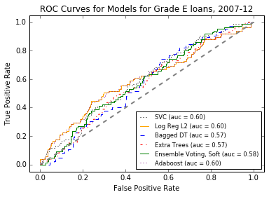
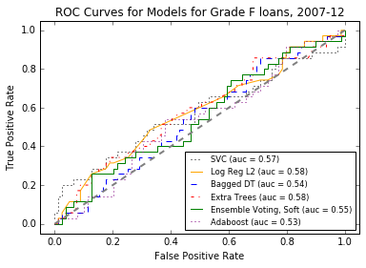
Models on Data Transformed with PCA had AUC (area under the curve) better than random luck...
An AUC score of .5 indicates random luck, and less than 0.5 is worse than random luck. The closer an AUC score is to 1, the better, as long as overfitting is not occurring.

Slide 9
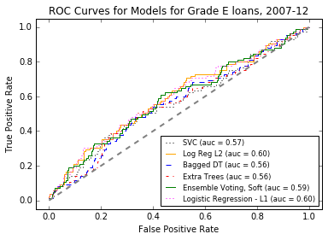
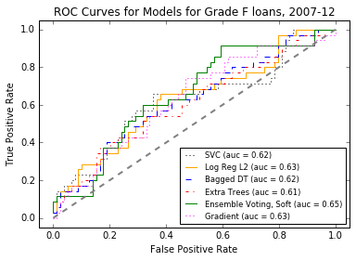
But the models built using feature selection to reduce the number of variables performed better for Grade F than PCA, and hence I favored this approach

Slide 10
For Grade F loans, the most important features via Random Forest include certain loan categories (debt_consolidation), engineered external data, and credit data
Features | Importance
revol_util | 7.11%
work_prop | 6.36%
diff_earliest_app_date | 6.14%
revol_bal | 6.12%
median_est_income_hh | 6.08%
magnitude_ann_inc_to_median | 5.93%
dti | 5.92%
annual_inc | 5.65%
int_rate | 5.47%
amnt_request | 5.31%
Features | Importance
open_acc | 4.79%
sub_grade_encoded | 3.91%
Risk_Score | 3.84%
public_record_ind | 2.69%
debt_consolidation | 1.90%
pub_rec | 1.43%
small_business | 1.33%
delinq_2yrs | 1.23%
RENT | 1.02%
verification_status_Verified | 0.95%

Slide 11
For Grade F loans, via Sequential Backwards Feature Selection, most of the best features were categorical, and these also happened to have a better AUC than via Random Forest Feature Importances
Features (1-10) | Features (11-20)
amnt_request | debt_consolidation
RENT | magnitude_ann_inc_to_median
emp_length_1 | medical
inq_last_6mths | moving
open_acc | renewable_energy
diff_earliest_app_date | vacation
ever_delinq_dummy | MORTGAGE
sub_grade_encoded | NONE
public_record_ind | OTHER
derog_record_present | debt_consolidation
credit_card | magnitude_ann_inc_to_median

Slide 12
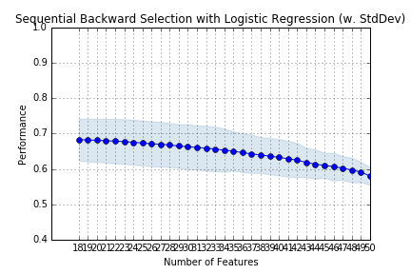
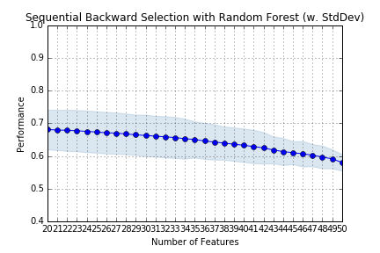
Grade F Loans: Performance improved when reducing features from the original 58

Slide 13
For Grade E loans, via Sequential Backwards Feature Selection, most of the best features were categorical, and the ones selected by Logistic Regression performed the best
Features (1-10) | Features (11-20)
int_rate | moving
annual_inc | other
inq_last_6mths | small_business
open_acc | vacation
pub_rec | MORTGAGE
revol_util | NONE
ever_delinq_dummy | emp_length_1
public_record_ind | emp_length_6
debt_consolidation | emp_length_7
educational | emp_length_9
home_improvement | verification_status_Verified
Model and Feature Set | Cross Validated ROC AUC Score
Log Reg - LR-SBS | 0.586
SVC - LR-SBS | 0.584
ET - LR-SBS | 0.579
ET - RF-SBS | 0.572
Log Reg - RF Feature Imp | 0.557
SVC - RF Feature Imp | 0.555
ET - RF Feature Imp | 0.550
Log Reg - RF-SBS | 0.547
SVC - RF-SBS | 0.545

Slide 14
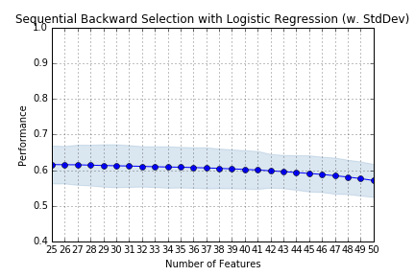
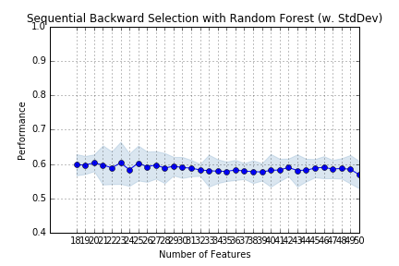
Grade E Loans: Performance improved when reducing features from the original 58 with Sequential Backwards Feature Selection, though improvement seemed to stop for Random Forest after 22 features were left

Slide 15
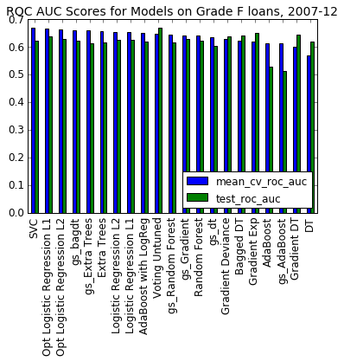
Grade F Loans: Most models performed better than random when validating on the test data, especially the two parametric models (Support Vector Machines and Logistic Regression)

Slide 16
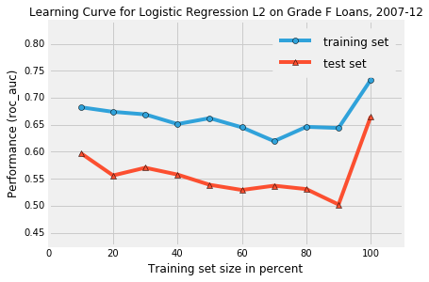
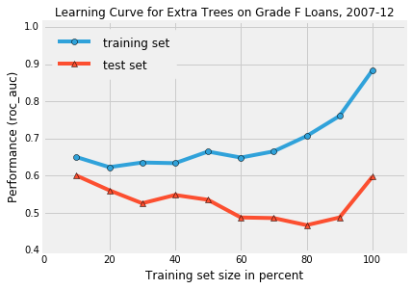
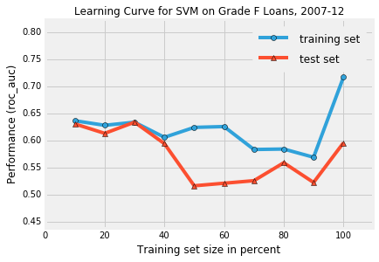
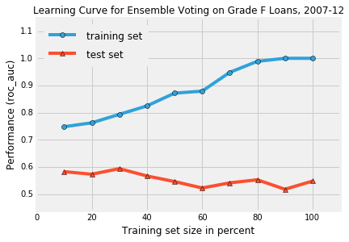
Grade F: The preferred parametric models were highly biased, but not as high variance as the non-parametric models, so I favored the former models

Slide 17
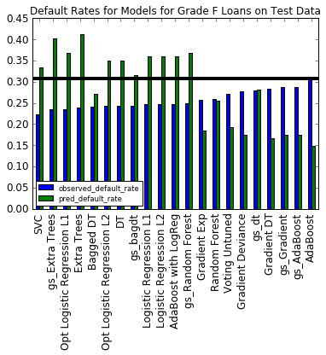
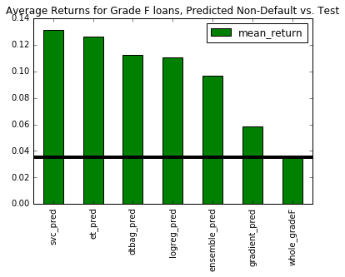
Grade F Loans: Models that over-estimated defaults performed the best for avoiding defaults and maximizing returns

Slide 18
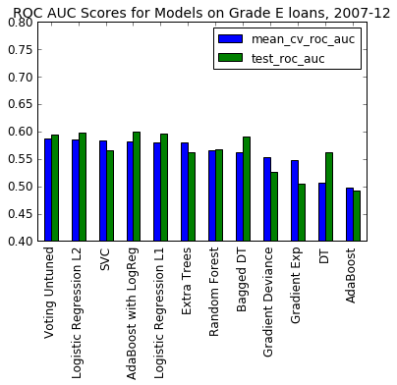
Grade E Loans: Ensemble Voting of Parametric and Non-Parametric models, AdaBoost on Logistic Regression, and Support Vectors and Logistic Regression were the best

Slide 19
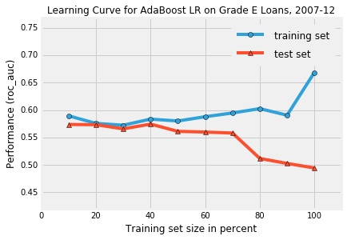
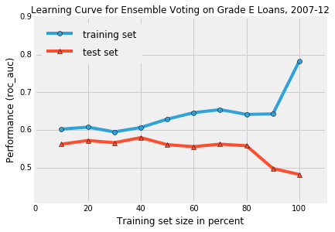
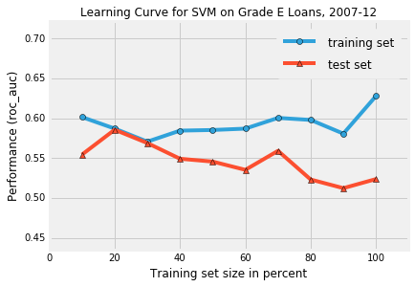
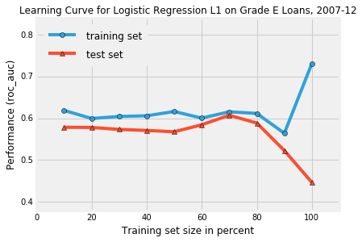
Grade E: The preferred models all had high bias, and increasing variance, suggesting the potential need to find more or other differentiating features

Slide 20
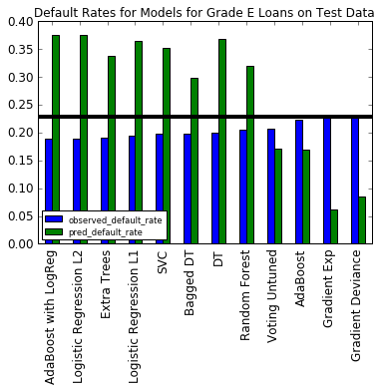
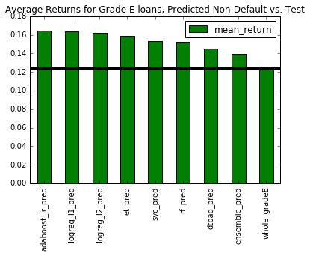
Grade E Loans: Models that over-estimated defaults performed the best for avoiding defaults and maximizing returns

Slide 21
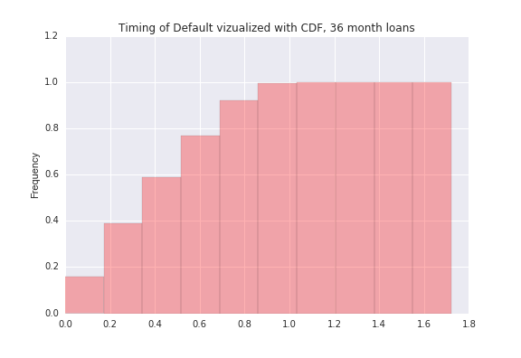
If using this model for production, I recommend semi-annual updating with data from loans two year prior to today, since most defaults occur within two years of issuance for 36 month loans

Slide 22
Next Steps
Re-model default rate by loan grades A through D (lower default rates, so less room for improvement)
Create a website that can accept loan characteristic input to predict if the loan will default or not, and display both the predicted result and probability.
Build a model for 36 month loans incorporating new Natural Language Processing information from employee title feature, and deploy to production if it beats current model
Build a model to optimize gross returns for 36 and 60 month loans
Build a neural network to predict default, and deploy if better

Slide 23
Appendix

Slide 24
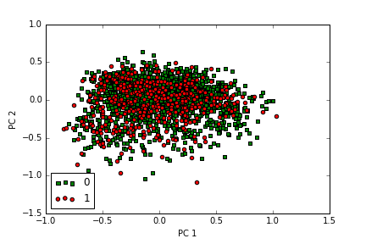
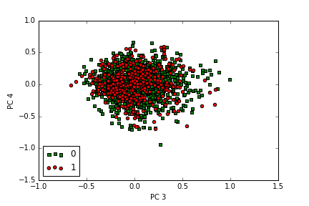
In performing PCA on Grade A, the data does not look easily separable, which is probably why all algorithms did not have a high AUC score (both for PCA and non-PCA)

